Slide 1
Car Parking System Using IOT
UNDER THE SUPERVISION OF
Dr. Vijay Kumar Chaurasiya

Slide 2
Problem Statement
It is very difficult to manage cars in big parking areas. Mismanagement will lead to
many problems for example heavy rush in the parking area, unnecessary environment
pollution, Honking causing sound pollution, wastage of time, sometimes accidents also.
So, all these problems can be reduced by making the parking area itself smart in a way
that it can prevent mismanagements and that too in a very cost effective way.

Slide 3
Methodology
Structure Of The System
1)ENTRY SECTION
2)PARKIG MANAGEMENT
3)EXIT SECTION

Slide 4
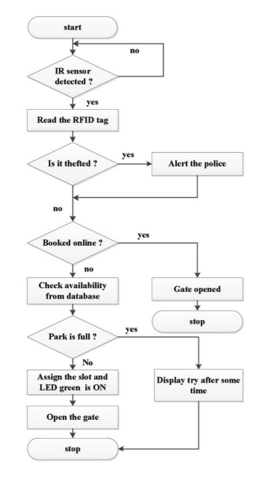
Entry

Slide 5
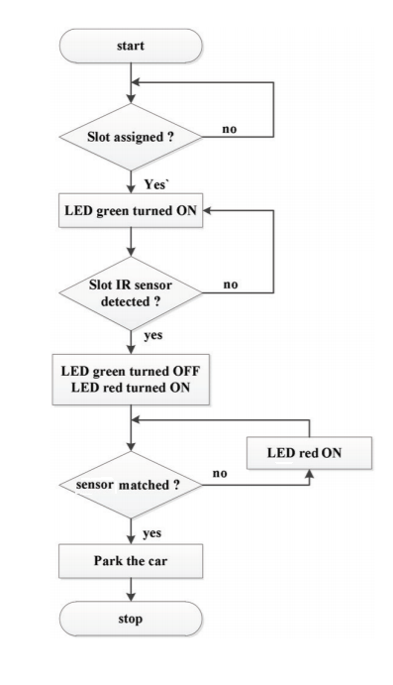
Parking management

Slide 6
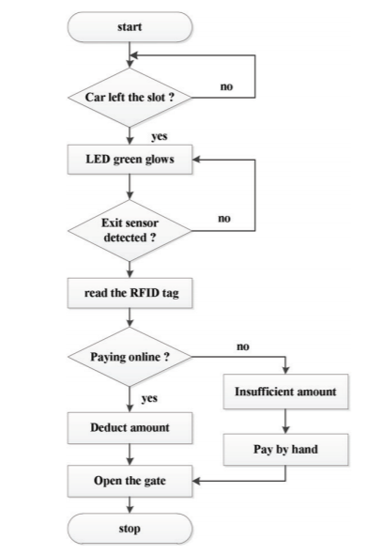
Exit

Slide 7
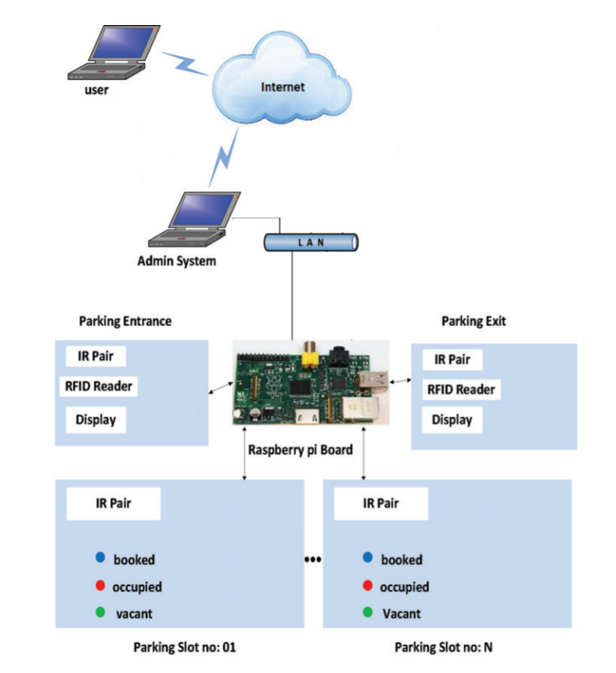
System Architecture

Slide 8
THANK YOU!

